Slide 1

Telco Customer Churn Analysis
Name : Abdul Azeem S
Batch :436

Slide 2
Agenda (This should be the PPT flow)
Business Problem Statement
Objective of the Project
Key analysis questions
Power Bi query results with screenshots or summaries
Final business insights and recommendations
Conclusion
Your Experience/Challenges working on Power Bi – Data Analysis Project.

Slide 3
Business Problem Statement
The company is losing a significant number of customers each month but does not clearly understand why they are leaving. Without knowing which customers are at risk or what factors drive churn, the business cannot take effective steps to retain them. A detailed churn analysis is needed to identify the causes, highlight high-risk segments, and support better retention strategies.

Slide 4
Objective of the Project
The main objective of this project was to:
Analyze customer churn patterns and understand why customers leave.
Identify important factors affecting churn (contracts, internet service, billing, add-ons).
Develop interactive Power BI dashboards for business stakeholders.
Provide data-driven recommendations to reduce churn and improve customer retention.

Slide 5
Key analysis questions
Which customers are churning, and what are their characteristics?
How do contract types and billing methods influence churn behavior?
What service-related factors (internet type, phone service, add-ons) contribute to churn?
How does customer tenure impact churn probability?
What is the revenue impact of churn (lost vs retained revenue)?
Which customer segments are at the highest risk of churning?

Slide 6
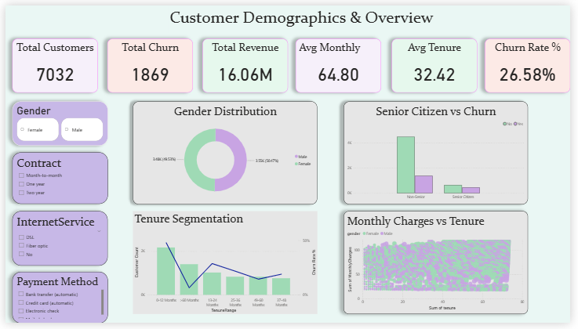
Customer Overview
Key Findings:
Overall churn rate is around 26.5%.
Senior Citizens show a significantly higher churn rate.
Short-tenure customers (<12 months) churn the most.
Monthly charges have a positive association with churn risk.
Gender distribution shows churn is not dependent on gender.
Visuals Included:
KPI cards (Customers, Churned, Revenue, Avg Charges, Tenure).
Gender Distribution Donut Chart.
Senior Citizen vs Churn Chart.
Tenure Segmentation (Bar + Line).
Monthly Charges vs Tenure Scatter.

Slide 7
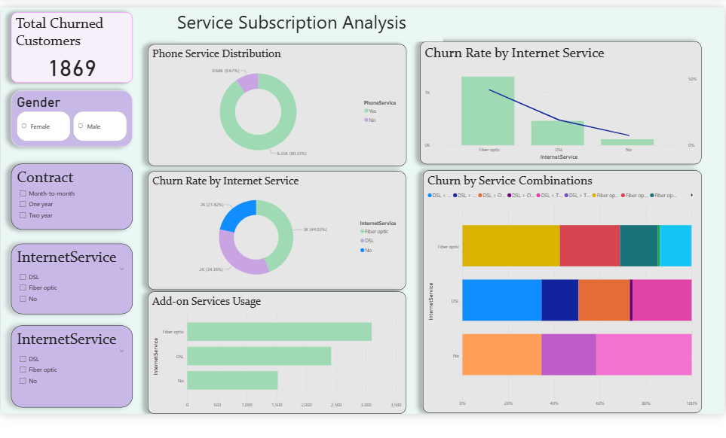
Service Subscription Analysis
Key Insights:
Fiber optic internet users have the highest churn rate due to performance or cost issues.
Customers with no add-on services are more likely to churn.
Add-on services like Tech Support and Online Security reduce churn, showing improved satisfaction.
More than 90% of customers use phone service, but churn is not directly linked to phone service usage.
Visuals Included:
Phone Service Distribution.
Churn Rate by Internet Service.
Add-on Services Usage (Bar).
Churn by Add-on Combinations.
Internet vs Contract Type Churn Table.

Slide 8
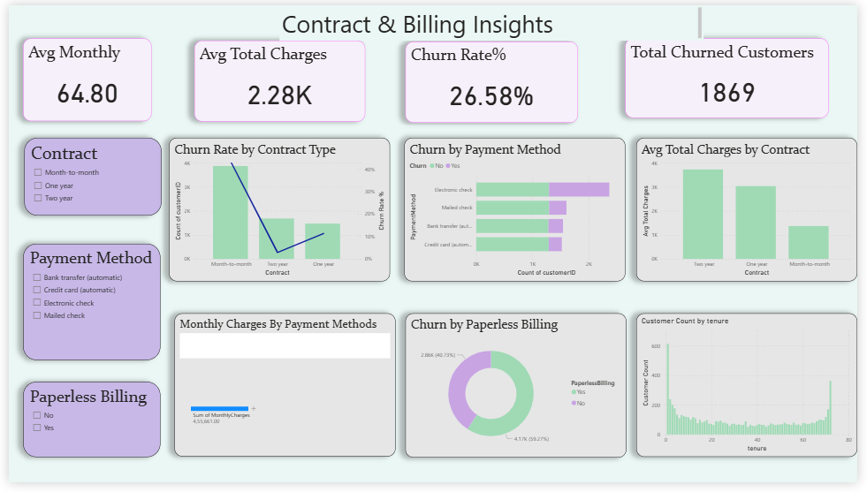
Contract & Billing Insights
Key Insights:
Month-to-month contracts have the highest churn rate compared to 1-year or 2-year contracts.
Electronic check payment method shows the highest churn rate, indicating dissatisfaction or ease of cancellation.
Total charges increase with longer contract duration — long-term customers offer higher revenue stability.
Paperless billing users have a slightly higher churn tendency.
Visuals Included:
Churn Rate by Contract Type.
Churn by Payment Method (100% stacked bar).
Avg Total Charges by Contract Type.
Monthly Charges by Payment Method (Box Plot).
Churn by Paperless Billing.

Slide 9
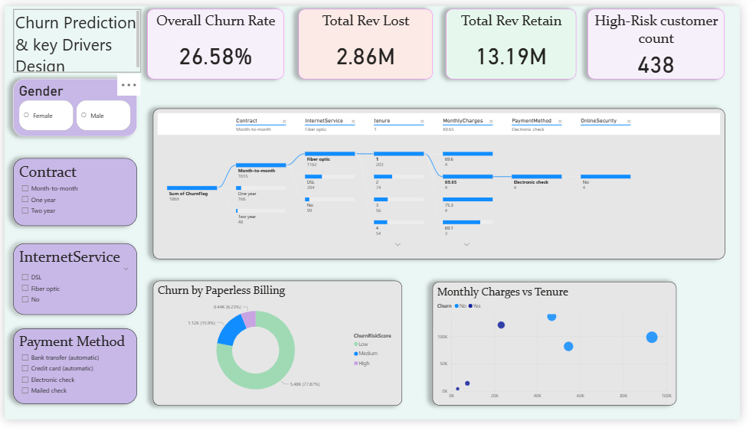
Churn Prediction & Key Drivers
Key Insights:
High-risk customers were identified using a churn risk scoring model (High, Medium, Low).
Revenue impact:
  Revenue Lost: Approximately $2.86M
  Revenue Retained: Approximately $13.19M
Customers with high monthly charges + low tenure are the most likely to churn.
Visuals Included:
Decomposition Tree
Churn Risk Score Donut
Monthly Charges vs Tenure (Colored by Churn)

Slide 10
Final Business Insights & Recommendations
1. Improve retention of Month-to-Month customers
Offer discounts for upgrading to long-term plans
Communicate value of contract stability
2. Investigate Fiber Optic churn issues
Analyze service complaints
Provide competitive pricing or speed upgrades
3. Promote Add-on Services
Bundle security + device protection + support
Offer 1-month free trials to improve adoption
4. Reduce churn in high-risk customers
Early intervention during the first 3 months
Personalized offers for customers with high monthly charges
5. Simplify billing experience
Reduce friction for electronic check users
Encourage switching to more stable payment methods

Slide 11
Conclusion
Customer churn is mainly driven by contract type, internet service quality, monthly charges, and low tenure.
Month-to-month customers are the most likely to leave the company.
Fiber optic users show higher churn, indicating possible service or cost issues.
Short-tenure customers (<12 months) churn the most, showing the need for early engagement.
Customers with no add-on services are more likely to churn.
Improving customer experience, offering contract upgrades, and targeting high-risk groups can significantly reduce churn.

Slide 12
Experience / Challenges Working on Power BI
Challenges Faced:
Cleaning inconsistent fields in Total Charges
Designing pixel-perfect dashboards
Creating DAX measures for churn, revenue, segmentation
Handling multiple visuals across 4 pages
Experience Gained:
Improved skills in Power BI modeling and DAX
Enhanced dashboard storytelling and visualization capabilities
Learned to create interactive, insightful multi-page dashboards
Real-world experience in solving a meaningful business problem

Slide 13

THANK YOU

